Slide 1
Training Ninja
James Joyce Team

Slide 2
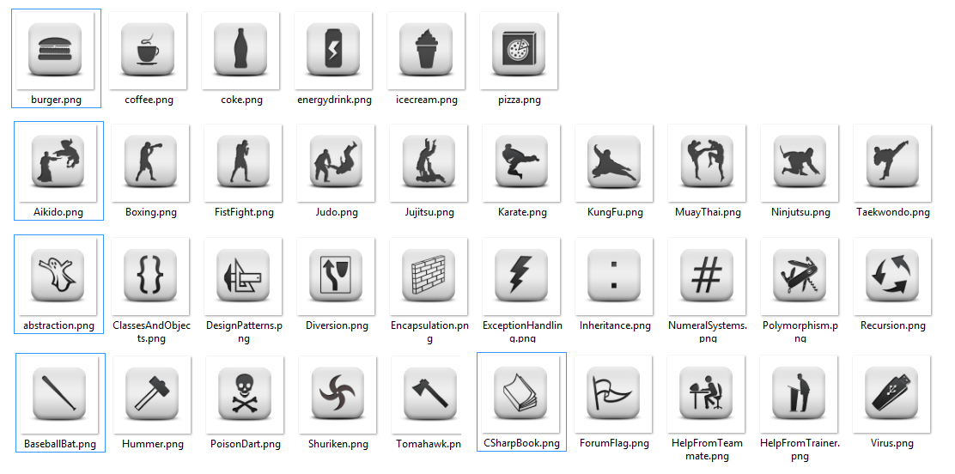
Project Description

Slide 3
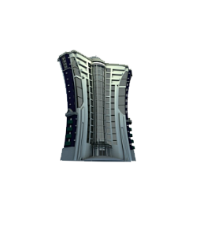

Project Description
Our hero is a ninja who lives in an uncertain world
Only one job can give him bright future, but he had to earn it
By hard training
And even harder studying

Slide 4





Project Description
To gain skill our ninja have to do some work out in the gym or take lessons in the academy
He should defeat massive count of enemies to get to the next level

Slide 5
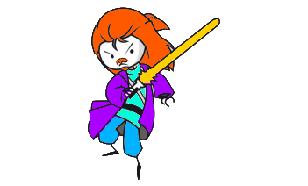


Project Description
He can take temporary job to earn some cash… but not without a fight though…
3 types of jobs
Compete for job today, just to be released tomorrow

Slide 6
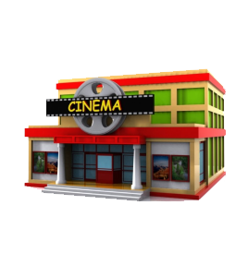



Project Description
Defeating the final Boss is not a simple thing. But ninja could buy some helpful things
Energizers from the Fast Food
Special Powers from the Mall
Or even grow his total energy at the Playground

Slide 7

Project Description
After fighting with countless Jedi, Bots and Assassins, our hero will meet his final enemy for one final battle - become a champion and change his future.

Slide 8

General Requirements

Slide 9
General Requirements
At least 5 interfaces (with one or more implementations)
ICommercial – Implemented in Energizer, SuperPower, Recreation
ICloneable – inherited by ICommercial
IItem – inherited by ICommercial , IAttack – multiple implementations
IAttack – Implemented in Power And SuperPower
?? Suggestion to implement IIenumerable<IItems>
At least 15 classes (implementing the application logic)
We have almost 40 classes including:
Abstract Classes
Static Classes
Sealed Classes

Slide 10
General Requirements
At least 3 abstract class (with inheritors)
Items
Creatures
Evil : Creatures
Job
Building
At least 1 exception class (with usage in your code)
ImproperlyDefinedCreatureException
ImproperlyDefinedItemException
ImproperlyDefinedBuildingException

Slide 11
General Requirements
At least 3 levels of depth in inheritance
Our deepest inheritance is:
Boss : Jedi : Evil : Creature
At least 1 polymorphism usage
?? To Do: Identify the polymorphisms in the game
Example: int damage = this.creature.Attack(this.fightRules); here the method Attack() is different for all the creatures
At least 1 structure
?? No – do we need coordinate system or something small and changeable to keep some data.

Slide 12
General Requirements
At least 1 enumeration
6 enumeration used, 4 of them with custom values
At least 1 event (with subscribers)
GUI uses events
At least 1 design pattern (e.g. Composite, Singleton, Factory, Wrapper, Bridge, Command, Iterator, …)
Singleton (lazy version used)

Slide 13

Additional Requirements

Slide 14
Additional Requirements
Follow the best practices for OO design: use data encapsulation, use exception handling properly, use delegates and events like it is recommended in MSDN, use inheritance, abstraction and polymorphism properly, follow the principles of strong cohesion and loose coupling.
Class Ninja lots of abstraction.
Evils – Attack using polymorphism. (especially Jedi and Boss)
Data Encapsulation is properly.
Events are used in UI
?? Cohesion/Coupling??

Slide 15
Additional Requirements
Obligatory use Git to keep your source code and for team collaboration (you might use https://github.com/). TFS or SVN are not allowed. Use Git.
https://github.com/JamesJoyceTeam-TheNinjaGame/NinjaRPG

Slide 16
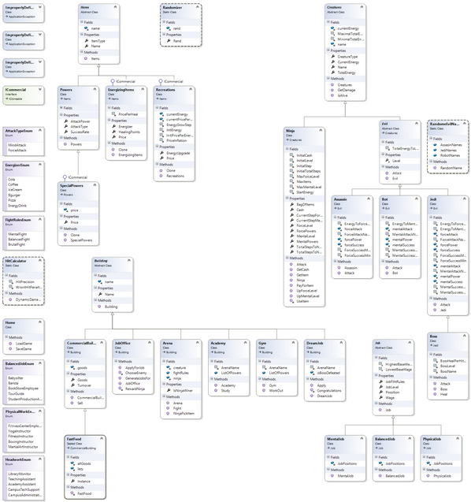
Additional Requirements
Provide a class diagram
(to visualize all types) :
http://git.io/92PEcg

Slide 17

Optional Requirements

Slide 18
Optional Requirements
Static members (fields, properties, constructor, etc.)
Static fields used in most of the buildings and all of the jobs
Static methods used in all Singletons and in the name randomizer
Constants, generic types, indexers, operators
?? If we make bag we will have it!
Lambda expressions and LINQ
Used in Ninja class and Commercial buildings for generic lists’ sorting.

Slide 19
Optional Requirements
Implementation of IEnumerable<T>, ICloneable, ToString() override
IClonable Override Implemented
?? IEnumerable<T> override not implemented ??
?? ToString() override not implemented ??
Namespaces (if your classes are too much)
?? They are too much but not implemented I will do it!!

Slide 20
Optional Requirements
User interface (UI) – console, graphical, web or mobile
Windows Forms
Live Demo

Slide 21
Thank you for training us!
James Joyce Team – “TRAINING NINJA RPG”

